Slide 1



Understanding the Role of
Artificial Intelligence in
Workforce Management

Slide 2

The World Economic Forum estimates that new technology could affect 1.4 million jobs in the United States alone by 2026.

Slide 3

More than half of Americans (58%) say technology (automation, robots, or artificial intelligence) poses a greater threat to jobs in the U.S. over the next decade than either immigration or trade.
  “AI Seen as Greater Job Threat Than Immigration, Offshoring”, March 2018, Gallup

Slide 4
76%
Americans “agree” or “strongly agree” that AI will fundamentally change the way people work and live in the next 10 years
73%
Say an increased use of AI will eliminate more jobs than it creates.
51%
Say learning “hard” skills, including math, science, coding and the ability to work with data, are the most important to maintain a job in the face of new technology adoption.
51%
Americans “agree” or “strongly agree” they would need additional training to secure a new position at an equivalent salary
Notes:
76% of Americans say AI will change the way people work and live over the next decade
77% of these U.S. adults say those changes will be positive
However, 73% say AI adoption will result in net job loss

Slide 5
POLL: In the near future, AI will…
Augment what my WFM staff is able to do today
Replace some of my WFM staff
Make no difference on what my WFM staff does today

Slide 6
Artificial Intelligence (AI) is…
a machine that can work and react like a human
a system, consisting of a series of algorithms, that can learn from constant input
a system that can learn and develop on its own

Slide 7

Early artificial intelligence models specified all possible choices to enable the computer to make decisions.
The “decision tree” had to be pre-programed to account for all eventualities.
Today, AI uses flexible models that enable the computer to make choices that include options not explicitly defined.
AI has many tools…
  search and mathematical optimization, artificial neural networks, statistical evaluation, probability analysis, machine learning
Notes:
The discipline of AI has made significant advances since its inception.
Early machine learning models specified all possible choices to enable the computer to make decisions.
The “decision tree” had to be pre-programed to account for all eventualities.
Today, however, machine learning uses flexible models that enable the computer to make choices that include options not explicitly defined.
The machine learns by being “fed” large amounts of information (input data), and initial decisions are “guessed” by the machine.
These initial “guesses” are then fine-tuned by comparing them to the “correct” answer or a specified expected outcome (output data).
The primary goal is to generalize beyond the instances in the input or output data — often called the training data — so that new information that arrives can be readily analyzed and acted upon without human intervention.

Slide 8

Machine Learning
It’s the “science of getting computers to act
without being explicitly programmed”
  Andrew Ng, adjunct professor at Stanford University and
  former head of Baidu AI Group/Google Brain.
Supervised Learning
  The computer is given examples of inputs and the resulting outputs from those inputs. The goal is to derive a rule or routine that processes the inputs to automatically predict the expected outputs.
Unsupervised learning
  The computer finds structure or patterns in the input data with no foreknowledge of the resulting outputs. The goal is to analyze raw data to find hidden patterns.
Notes:
Machine learning (ML) is a subset of AI. The term
was coined in 1959 to describe a process whereby
algorithms can learn from and make predictions on
data. It’s the “science of getting computers to act
with-out being explicitly programmed,” writes Andrew
Ng, an adjunct professor at Stanford University and
former head of Baidu AI Group/Google Brain.

Slide 9








AI in your contact center
We have deployed AI in the following areas…
Automated Customer Interactions
Email Response
Agent Robotic Automation
Workforce Management
Chat Bots or NLP
A.I.
Other
Voice of the Customer or Interaction Analytics

Slide 10

It is time for WFM Solutions to embrace AI technology
Computing power and data analytics have advanced to where it is possible to use Artificial Intelligence and Machine Learning to make WFM solutions more accurate and provide greater returns to the organization.

Slide 11




AI-Infused Talent Acquisition
Strategic and Tactical
Forecasting with Artificial Intelligence
Scheduling with Machine Learning

Slide 12

Accuracy is Strength
The single greatest business opportunity that is now emerging in the global marketplace is the ability to analyze digital log data to trace digital actions and from those traces to develop algorithms that can predict future outcomes with greater accuracy.
Geoffrey Moore, author, speaker, and advisor on disruptive innovations
Greatest business opportunity…Analyze data …predict outcomes with greater accuracy.

Slide 13


AI-Infused Talent Acquisition
Predictive Analytics for Employee Selection
HIRING RECIPE
PREDICTIVE ANALYTICS
RECOMMENDATIONS
VIRTUAL
INTERVIEW
LANGUAGE
TESTING
QUIZZES &
TESTS
HIRE
RIGHT AWAY
PROCEED
WITH CAUTION
DO NOT
HIRE
AFTER CANDIDATE COMPLETES THE INTERVIEW, VOICE AND DATA IS FED INTO AN EMOTIONAL AFFECT PREDICTIVE MACHINE LEARNING MODEL
Predictor of employee engagement
* includes digital voice and video capture
** includes fluency, proficiency, comprehension, critical thinking, active listening
*** includes math, typing, data entry, custom quizzes, EEOC survey, custom survey, custom qualifier assessment

Slide 14


AI-Infused Talent Acquisition
Value of AI-Infused Talent Acquisition
84%
60%
56%
34%
  Reduction in Time-to-Fill
  Open Positions
  Improvement in Retention
  Increase in
  First Call Resolution
  Reduction in
  Transfer Rate
Notes:
46 new algorithms
4 new models
Exponential smoothing
Multilinear seasonal regression
Box-Jenkins ARIMA
Best pick

Slide 15




Forecasting with Artificial Intelligence
Value of Forecasting With AI
  Multiple forecast models in a single generation with AI Best Pick
  Adaptive to changing patterns
  Increased accuracy of staffing plan
  Increased operational efficiency
Notes:
46 new algorithms
4 new models
Exponential smoothing
Multilinear seasonal regression
Box-Jenkins ARIMA
Best pick

Slide 16
Forecasting with Artificial Intelligence
Expand beyond traditional time- series weighted moving averages
Choose a specific model to detect patterns in historical data
Deploy multiple models simultaneously across the enterprise
Use back-casting for validation and best pick selection of a model for each LOB

Slide 17


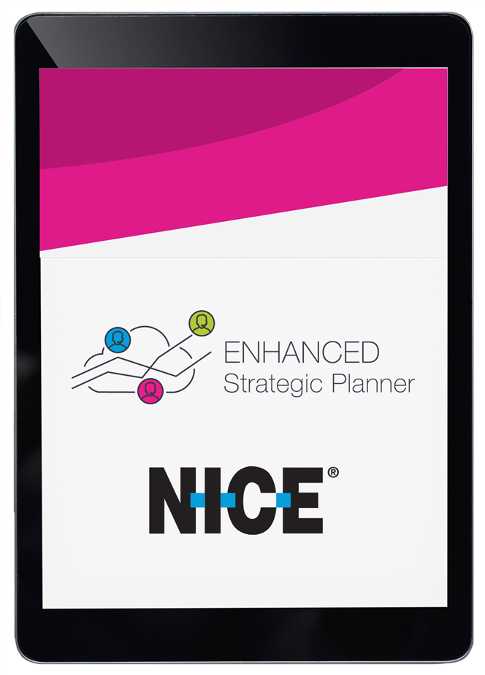


Importance of Use-ability

Slide 18


All Math Models are Great,
But I Don’t Have a PHD
AI

Slide 19


True Modelling Answers More Than 1 Question
Reverse Solve For Performance Target

Slide 20







Enhanced Strategic Planner with Artificial Intelligence
  Long-Term Forecasting with Artificial Intelligence
  Detailed Shrinkage Planning by Category
  Performance Targets for Service Level, ASA
  Reverse Solve for Performance Targets
  New Intuitive Web-based User Interface and Experience
  Cloud deployment with continuous updates and login anywhere

Slide 21






Scheduling Intelligence
SKILL USE EFFICIENCY
SKILL USE ASSESSMENT
SCHEDULE FAIRNESS
CLOSED-LOOP OPTIMIZATION

Slide 22

Skill Use Assessment Intelligence
The significant challenge in today’s omnichannel work centers:
  accurately estimate when and to what extent an employee needs to be shared across multiple work streams.
Without a reliable understanding and prediction of the time an employee will contribute to each work area, the use of multi-skilled employees can lead to poor decisions… and poor customer service.
Skill Use Assessment is best determined using predictive analysis embedded in a discrete event simulator.

Slide 23

Skill Use Efficiency Intelligence
Erlang has two significant assumptions that are not valid in today’s modern work center:
it assumes all employees share a homogenous skill assignment and
work items queue to a single skill profile
This is rarely true in today’s work center. The net effect of these assumptions is to overstate the required lines.
Solve this FTE overstatement by adding intelligence directly to the required line calculation. The intelligence automatically learns the skill use efficiencies that are inherent in each unique work center.
Skill Use Efficiency is best determined using learning models embedded in a discrete event simulator.

Slide 24



Why is simulation needed?
Mathematics Only Represent Dependent and Independent Variables
Simulations Create a Machine Model Which Considers the Entire Framework
Notes:
Mathematical formulas can only represent dependent and independent variables based on past experience
Formulas assume history repeats itself
When an independent variable relationship changes, the formula must be rewritten
Simulation creates a model which reflects the framework of the interrelationships between customers, employees, skills, technology, contact routing algorithms, and management techniques

Slide 25



Where Simulation with Machine Learning fits in WFM
Interactions
Historical volume
and AHT
Forecasting with
artificial intelligence
Forecasted interaction
volume and AHT
Requirements,
service level, ASA,
occupancy objectives,
other parameters...
Schedule by skill and interval
Skill Usage Assessment
Simulation of routing
rules & skills

Slide 26

Closed-loop Optimization Intelligence
This concept leverages the form of machine learning in which the machine learns by being fed large amounts of information, with initial decisions that are “guessed” by the machine.
The initial “guesses” are then fine-tuned through a
process of comparison to the expected outcome.
A closed loop feedback schedule optimization is how WFM systems solve for multiple variables when faced with several unknowns inherent in an omni-channel environment.

Slide 27
Where Simulation with Machine Learning fits in WFM
Interactions
Historical volume
and AHT
Forecasting with
artificial intelligence
Forecasted interaction
volume and AHT
Requirements,
service level, ASA,
occupancy objectives,
other parameters...
Schedule by skill and interval
Skill Usage Assessment
Simulation of routing
rules & skills

Slide 28




Schedule Fairness Intelligence - Examples
Adaptive Assignment
When WFM is integrated with performance management’s capabilities, work schedules can be assigned using uniquely identifiable metrics, attributes and preferences of each employee.
Preference Persona Assignment
Even without the advanced AI available in performance management, WFM should offer a robust persona that each employee self-manages. The capabilities include self-identified work time availability, which is guided by the machine to ensure that basic coverage is provided by each employee. Employees may also define a customized preference persona that reflects not only the desire for preferred shift elements (such as start time, stop time, days off, lunch length, work day patterns, shift length, lunch times, etc.), but also the relative priority of each element as perceived by the employee. The machine constantly monitors for changes in preference personas and adjusts assignments accordingly.
Policy Assignment
No one likes to be repeatedly assigned to shifts that are considered less desirable. To help create a fair workplace, WFM should integrated intelligent policies that manage schedule creation and schedule assignment fairly while meeting customer needs. For example, a policy may state that every employee must work a late afternoon shift at least once every three weeks, subject to fluctuating customer demand. Or, alternately, certain sequences of shifts may be monitored by the machine to ensure employees are fairly assigned to back-to-back shift types. These machine algorithms are designed to balance the needs of the business with the needs of the employee while eliminating the human intervention often required to retain fairness.
Fairness Assignment
Some people want to volunteer to work certain days of the week, weekends or holidays, while others want to be rotated through the assignments fairly. WFM fairness intelligence monitors assignment history, fairness credits (which can be tied to performance management), volunteerism, work rules and business need to manage the work day assignments fairly.

Slide 29





Scheduling Intelligence
Admin
Hours
9%
Schedule
Shrinkage
7%
SKILL USE ASSESSMENT
SKILL USE EFFICIENCY
Accurate productive time allocation
Trustworthy schedule open projections
Accurate change management decisions
Trustworthy required lines
Reduced headcount & OT expenses
Improved VTO planning
Forecast
Accuracy
8%
Occupancy
Rates
9%
CLOSED-LOOP OPTIMIZATION
SCHEDULE FAIRNESS
Improved employee satisfaction
Reduced administration
Increase employee engagement
Improved schedule optimization
Reduced net staffing variances
Increased automation of
planning tasks
Overtime
Hours
6%
Abandon
Rates
5%

Slide 30
Thank you
Paul Chance
NICE Systems paul.chance@nice.com

